Slide 1
Effect of an Atmospheric Pressure Plasma Treatment on the Mode I Fracture Toughness of a Co-Cured Composite Joint

Slide 2
1.Introduction
Convenient to co-cure the two materials using single processing process
Pros:
  Reduces cost
  Reduce processing time
Cons:
  Epoxy resin contains moisture(free and bounded) → interfacial failure
To eleminate the drawback:
  Apply plasma treatment on the surface → Too much treatment is detrimental

Slide 3
Most paper focuses plasma treatment on second bonding composite
This paper investigates the effect on co-cured joints

Slide 4
2.Manufacture&Methods
Materials:
177 °C cure unidirectional carbon-fiber/epoxy prepreg (CYCOM 977-2/HTS)
Dual 120/177 °C cure epoxy film adhesive (FM300-2M)
Each substrate consists 10plies of 977-2/HTS prepreg
Specimen:
Width:25mm Length:150mm Thickness:5.6mm Initial Crack Size:45mm

Slide 5
2.1 Fracture Test Methods
Double cantilever beam test with British Standards 7991
Constant crosshead displacement: 1mm/min
Three repeats on each specimen
2.2 Scanning Electron Microscopy Method
2.3 Thermal Characterisation Methods
Heated from 25°C to 350°C (10 °C /min)
To determine glass transition temperature

Slide 6
2.4 Surface Energy Characterisation
Sessile drop technique
Surface energy is calculated with OWRK method.
2.5 Labline Plasma Treatment System
Constant speed: 1.5 m/min
Applied only on two prepreg surface that direct contact with film adhesive
2.6 Optical Emission Spectroscopy
To analyze plasma content
Always N2 peaks in spectrum(diffusion of air into plasma)
He/O2 leads more interaction with prepreg → higher surface energy

Slide 7
2.6 X-Ray Photoelectron Spectroscopy
To study chemical composition of treated surfaces
Mean of 3 measurement on different spots

Slide 8
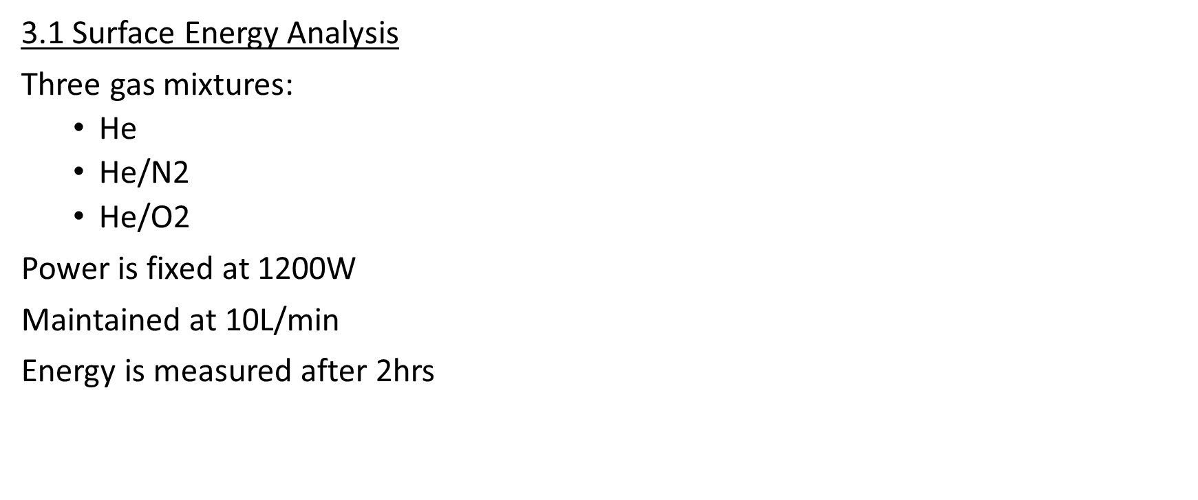
3 Result&Discussion

Slide 9
3.2 Mode I Fracture Toughness
He/O2 treatment at 1600W

Slide 10
3.3 XPS Analysis
Samples that treated with He/O2 at 1250W for 5 phase
The presence of sulphur (thermoplastic toughening agent or agent in resin)
Silicon concentration is in decrease(contamination)
3.4 Microscopy and Thermal Analysis
Long treatment → reduced fracture tougness in co-cured joints
????

Slide 11
4 Conclusion
He/O2 treatment is effective in increasing surface energy of prepreg.
He and He/N2 is very inefficient in increasing the surface energy.
Excessive treatments leads severe degradation in the performance under Mode I.
Highly polar surface attracts moisture to the interface.
Long plasma treatment causes pitting →reduction in fracture toughness

